Slide 1
Network Security & Cryptography
Dr. Uttam Ghosh
Vanderbilt University
Computer Science
Uttam.ghosh@vanderbilt.edu

Slide 2
Outline
Countermeasures- Overview
Cryptography
Symmetric key
Asymmetric key
RSA
Diffie-Hellman Key Exchange
Integrity & Authentication
Hash Function
Message Authentication Code (MAC)

Slide 3
Network Security
Network security consists of a set of rules to prevent and monitor unauthorized access, misuse, modification, or denial of a computer network and network-accessible resources.

Slide 4
Type of Attacks
Passive Attack: Attacker attempts to learn or makes use of information from the system but does not affect system resources. This includes traffic analysis, monitoring of unprotected communications, decrypting weakly encrypted traffic, and capturing authentication information such as passwords.
Active Attack: Attacker attempts to alter system resources or affect their operation. This can be done through viruses, worms, or Trojans.
Insider Attack: An insider attack initiated by an insider such as a disgruntled employee, attacking the network.
Outsider Attack: An "outside attack" is initiated from outside the perimeter, by an unauthorized or illegitimate user of the system (an "outsider").
Denial of Service (DoS) Attack: The act of denying an user of a particular service or network resource.

Slide 5
Security Objectives
Integrity: is the Received and Sent content same?
Confidentiality: don’t encourage spying
Authentication: to confirm your identity.
Authorization: to ensure control of access, only authorized users get to the data
Non-repudiation: Neither sender nor receiver can deny the existence of a message
Availability: Legal users should be able to use whenever need arises.

Slide 6
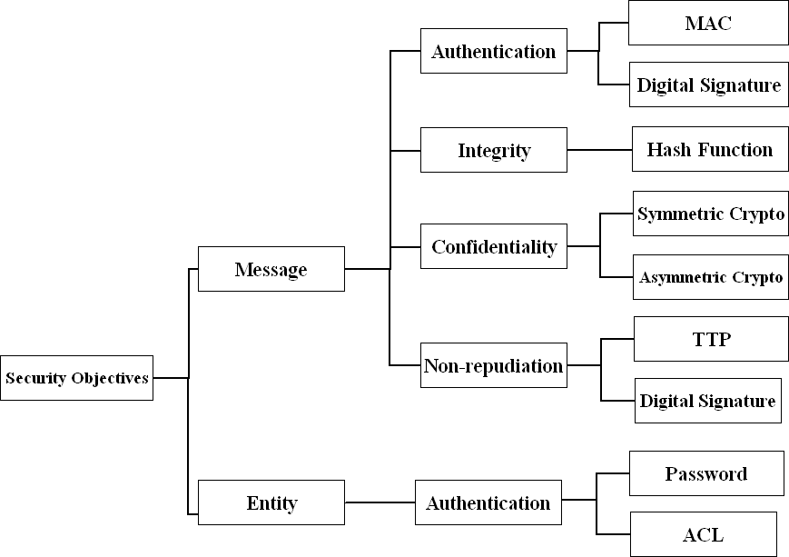
Security Objectives II

Slide 7
Countermeasures
Cryptography: a tool to provide data confidentiality
Firewall: a hardware or software or combination of both designed to permit or deny network transmissions based upon a set of rules and is frequently used to protect networks from unauthorized access while permitting legitimate communications to pass.
Intrusion detection system: a tool to monitor user traffic and generating warnings for malicious activity
Trust : societal trust; between neighbors, friends: A relation between nodes from past behaviors to ensure reliable delivery of data

Slide 8
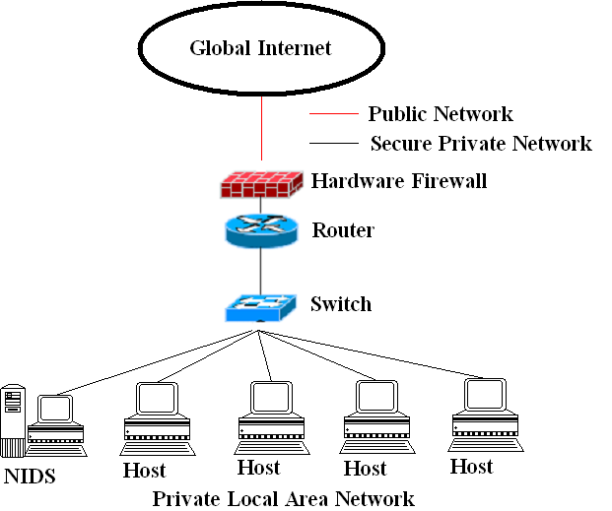
Countermeasures II

Slide 9
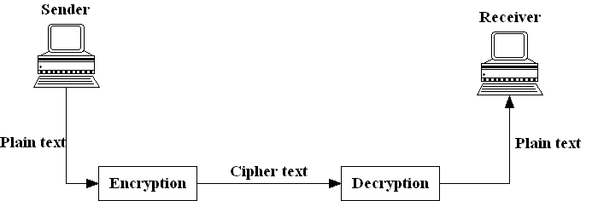
Cryptography
Adopted from Greek Word means “Secret Writing”
Mainly used to protect information from attackers.

Slide 10
Basic Terminologies
Encryption
process of encoding a message so that its meaning is not obvious
Decryption
Decryption is the reverse process, transforming an encrypted message back into its normal, original form
Cryptosystem
A system for encryption and decryption is called a cryptosystem.

Slide 11
Basic Terminologies
Plaintext: Original text need to be sent
Ciphertext: Encrypted form of plaintext
Key: key refers to a sequence of symbols or a numerical value used by an algorithm to alter information & making that information secure
Encryption algorithm: The cryptosystem involves a set of rules for how to encrypt the plaintext and how to decrypt the cipher text.
Cryptanalysis: Cryptanalysis is an attempt to break the cipher text.

Slide 12
Cryptography Classification
Cryptography
Symmetric
Asymmetric

Slide 13
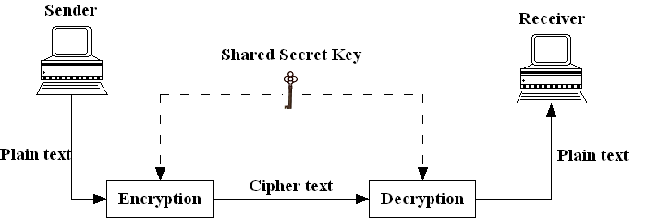
Symmetric-key Cryptography
Same key is used by the sender (for encryption) and the receiver (for decryption).

Slide 14
Traditional Ciphers
Traditional Ciphers
Substitution Ciphers
Monoalphabetic
Polyalphabetic
Transposition Ciphers

Slide 15
Substitution Ciphers
A substitution cipher replaces one symbol with another.
Monoalphabetic: Each occurrence of a letter in the plaintext is substituted by a fixed letter (irrespective number of occurrence) to form the ciphertext.
Example:
Polyalphabetic: Each occurrence of a letter in the plaintext is substituted by a different letter to form the ciphertext.
Plaintext: HELLO
Key: 3 (Down)
Ciphertext: KHOOR
Plaintext: HELLO
Ciphertext: ABZNF

Slide 16
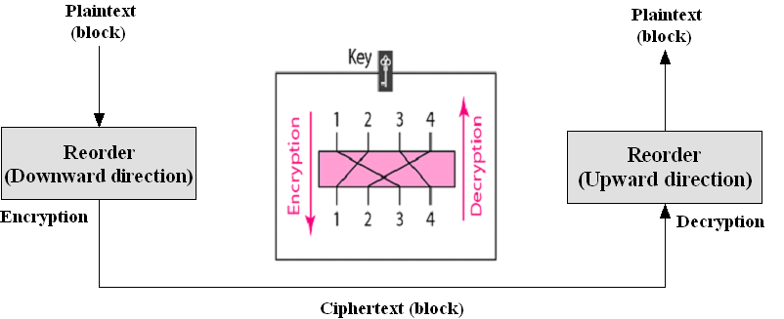
Transposition Cipher
A transposition cipher reorders (permutes) symbols in a block of symbols.
Example:
Plaintext: HELLO MY DEAR
Ciphertext: ELHLMDOYAZER

Slide 17
Symmetric-key Algorithms
Data Encryption Standard (DES): 56 bits key
Advance Encryption Standard (AES): 128, 192 or 256 bits key
Advantage: Faster than asymmetric-key
Disadvantage: Needs O(n²) number of shared keys where n is the number of nodes

Slide 18
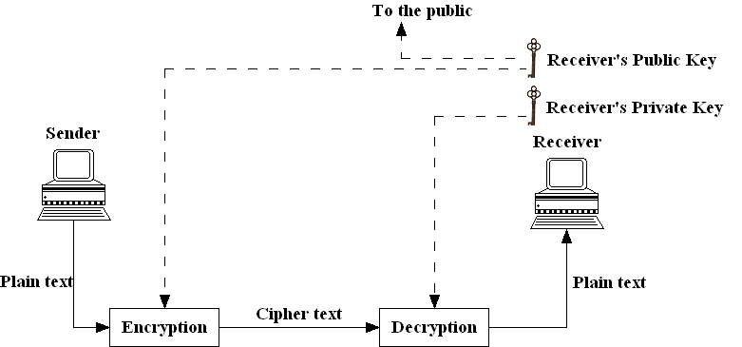
Asymmetric-key Cryptography

Slide 19
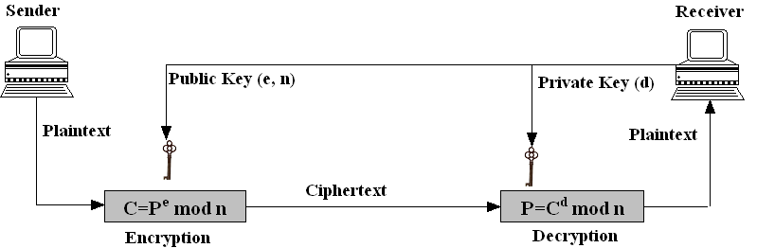
RSA Algorithm

Slide 20
RSA Key Generation
Choose two large prime numbers p and q.
2. Compute n = p*q, Φ(n) = (p-1)*(q-1).
3. Choose e (less than n) such that e and Φ(n) are relatively prime (having no common factor other than 1).
4. Choose d such that e*d mod Φ(n) is equal to 1.
Public key (n, e) and private key (d)

Slide 21
RSA Key Generation: Example
Node B (Receiver)
Chooses two random numbers p=7 and q=11.
Computes n = 7 * 11 = 77, Φ(77) = (7 − 1)*(11 − 1)=60.
Chooses e=13 such that 13 < 77, 13 and 60 are relatively prime.
Chooses d: so that 13*d mod Φ(77) = 1; d=37
int Gen_d() {
for(int d=1; i<60; d++) {
if ((13*d)% 60 == 1)
return d;
}
}

Slide 22
RSA Encryption/Decryption: Example
Encryption: Node A (Sender) wants to send the plaintext 5 to Node B. It generates ciphertext 26 from plaintext 5 using the public key 13 (of Node B) and sends to Node B.
Plaintext: 5
C = 5¹³ = 26 mod 77 = 26
Ciphertext: 26
Decryption: Node B (Receiver) receives the ciphertext 26 and uses the private key 37 to generate the plaintext 5:
Ciphertext: 26
P = 26³⁷ = 5 mod 77 = 5
Plaintext: 5

Slide 23
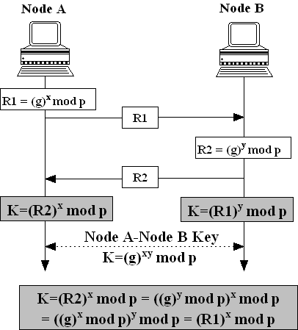
Diffie-Hellman Key Exchange

Slide 24
Diffie-Hellman Key Exchange
Steps in the algorithm:
Node A and Node B agree on a prime number p and a base g.
2. Node A chooses a secret number x, computes R1= (g)^{x} mod p and sends R1 to Node B.
3. Node B chooses a secret number y, computes R2= (g)^{y} mod p and sends R2 to Node A.
4. Node A computes secret key K=(R2)^{x} mod p.
5. Node B computes secret key K=(R1)^{y} mod p.

Slide 25
Diffie-Hellman: Example
Assume public parameters are g = 7 and p = 23.
The steps are as follows:
1. Node A chooses x = 3 and calculates R₁ = 7³ mod 23 = 21.
2. Node B chooses y = 6 and calculates R₂ = 7⁶ mod 23 = 4.
3. Node A sends the number 21 to Node B.
4. Node B sends the number 4 to Node A.
5. Node A calculates the symmetric key K = 4³ mod 23 = 18.
6. Node B calculates the symmetric key K = 21⁶ mod 23 = 18.
The value of K is the same for both Node A and Node B: g^{xy} mod p = 7¹⁸ mod 23 = 18.

Slide 26
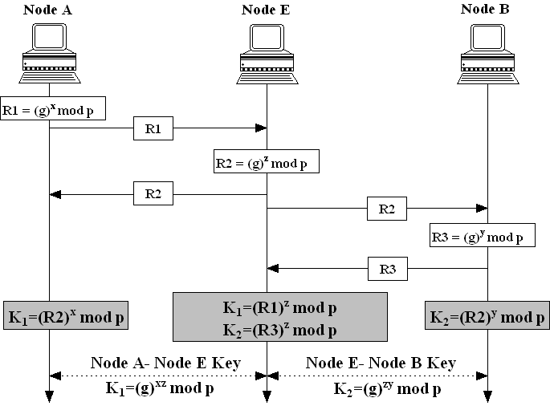
Diffie-Hellman: Man-in-Middle Attack

Slide 27
Symmetric and Asymmetric: Comparison
Symmetric key size (AES) | Equivalent Asymmetric key size (RSA Public key) | Security Status
80-bits | 1024-bits | Broken
112-bits | 2048-bits | Secure till 2030
128-bits | 3072-bits | Secure beyond 2030

Slide 28
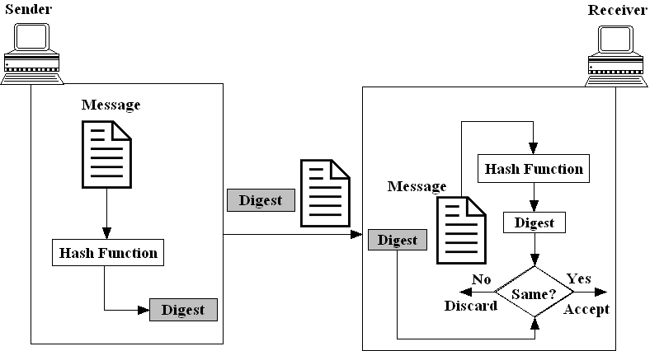
Message Integrity

Slide 29
Hash Function
The properties of hash function
One-way: the digest can only be created from the message, but not vice versa
One-to-one: be very difficult to find two messages that create the same digest.
The common hash functions are:
Message digest 5 (MD5)
Secure hash algorithm (SHA-1)
Secure hash algorithm (SHA-2)
Secure hash algorithm (SHA-3)

Slide 30
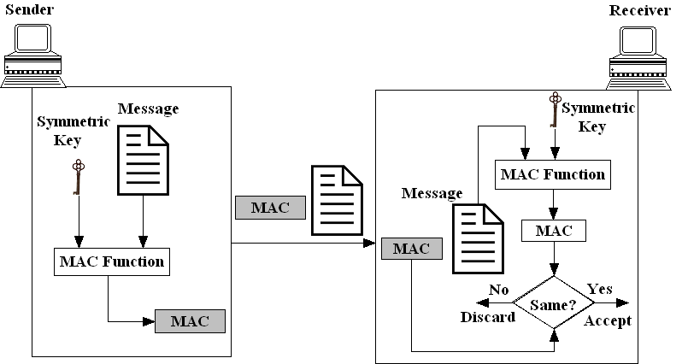
Message Authentication Code

Slide 31
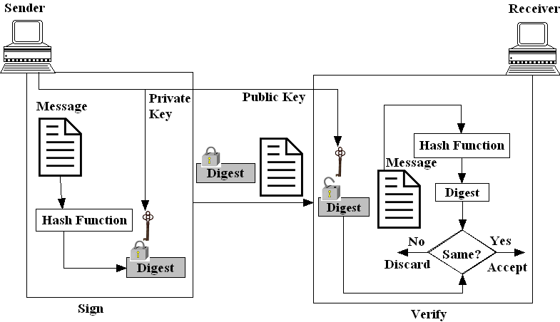
Digital Signature

Slide 32
Network Security: Tips
Use antivirus software
Insert firewalls
Use IDS
Update OS and software periodically
Safe browsing
Do not save account information
Set strong password and change periodically
Uninstall unnecessary software
Maintain backup
Check security settings

Slide 33
Further Study
B. A. Forouzan, “Cryptography and Network Security,” Mc Graw Hill, 2006.
W. Stallings, “Cryptography and Network Security,” Pearson, 2014.
J. F. Kurose, K. W. Ross, “Computer Networking,” Addison Wesley.
Ahmad Al-Ghoul, “TCP/IP layers and vulnerabilities (module 9),” Philadelphia University, 2011.
J. Mitchell, “Network Protocols and Vulnerabilities,” http://www.slideserve.com/larya/network-protocols-and-vulnerabilities, Stanford University.

Slide 34



